Slide 1

Design Portfolio
Yingying (Judy)

Slide 2
个人简介
About Me
学习工作经历
Education & Professional Experiences
我面对看似一团乱的问题能够找到切入点，并且付诸行动
实实在在去验证自己的想法可行不可行。
即使失败了我也立马能回血~喜欢尝试各种新鲜的事物。
我用自己的努力去获得想要的生活。
2021.05-2022.12
Centennial College
Software Engineering
I can find an entry point in a seemingly messy problem and put it into action. I always test whether my idea is feasible or not by actions.
Even if I fail, I never lose my faith. I like to try all kinds of new things.
I use my own efforts to get the life that I want.
2018.10-2020.10
Dell (China)
Account Manager Inside Sales
2014.06-2018.08
SHANGHAI MINGGANG LCD,
User Interface Design
Phone：647-878-2843
S
A
P
P
k
i
A
r
s
e
Mail：judyfeng9@gmail.com

Slide 3

How are you today? :D
Video & Animation Editing
APP Design
Web Site Design
Graphic Design
Commercial Photography

Slide 4

Video & Animation Editing

Slide 5


AE弹跳变形重力等综合展示
Ae Animation
多个画面剪切添加元素等综合展示
Video Editing

Slide 6

APP Design

Slide 7


Slide 8
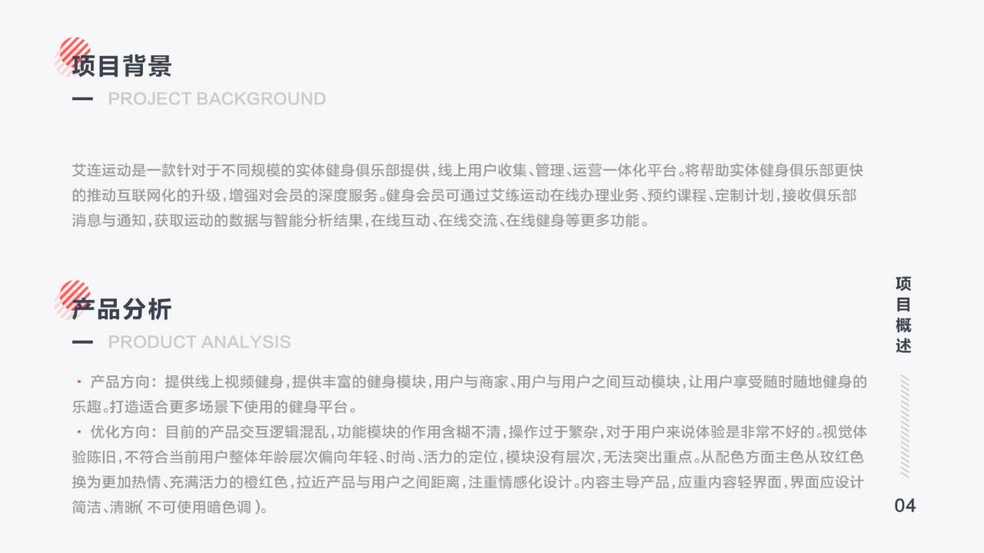

Slide 9
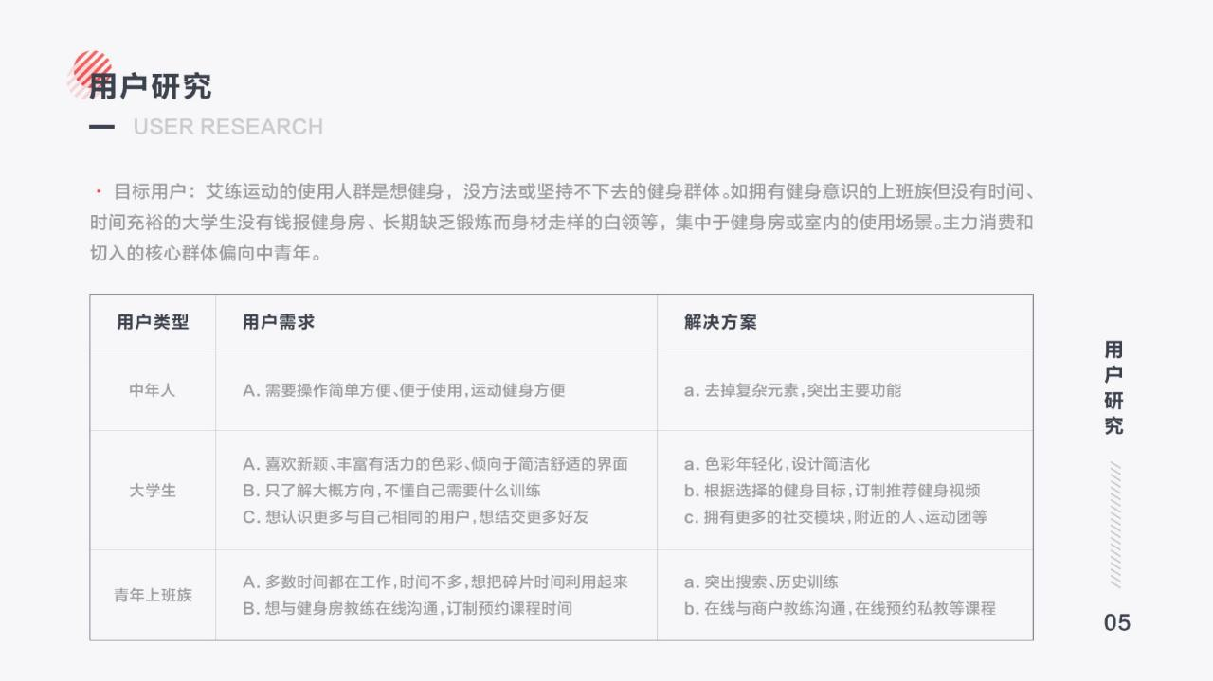


Slide 10
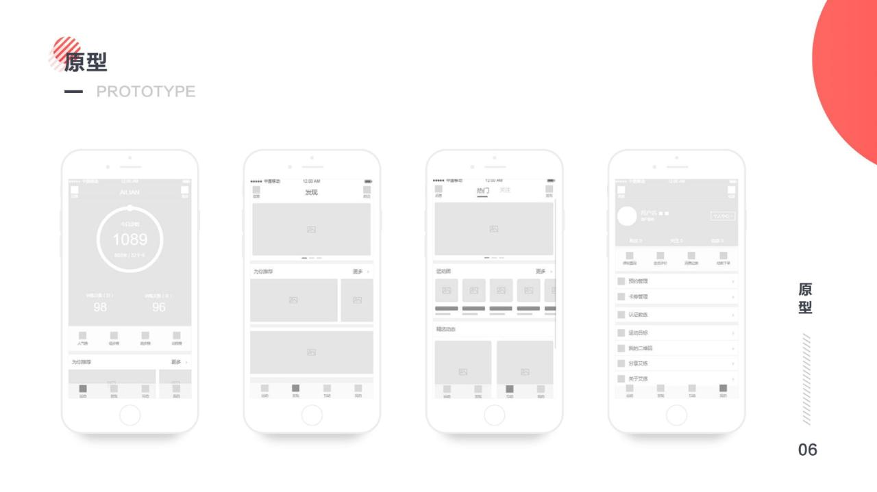

Slide 11
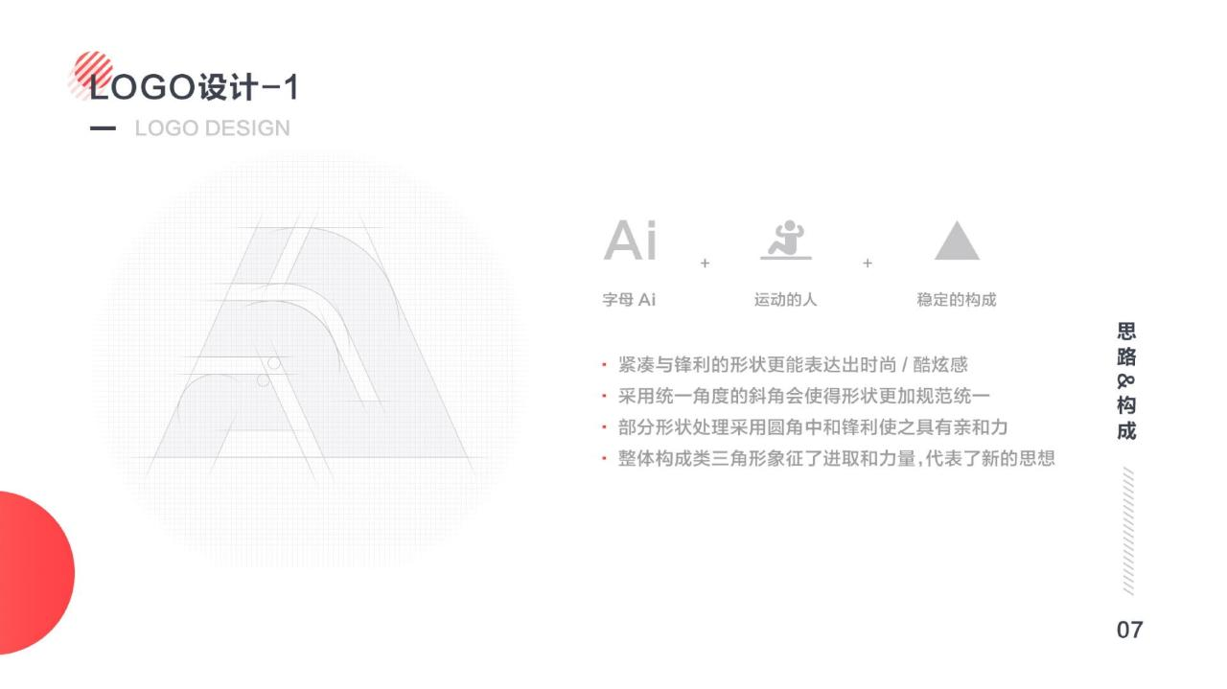

Slide 12


Slide 13
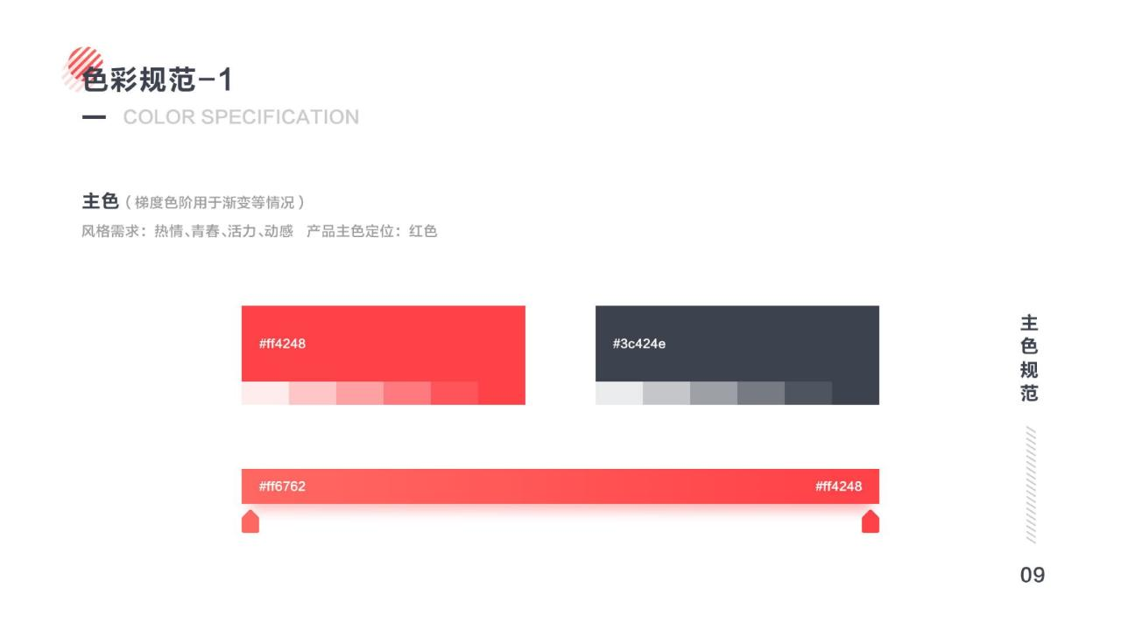

Slide 14
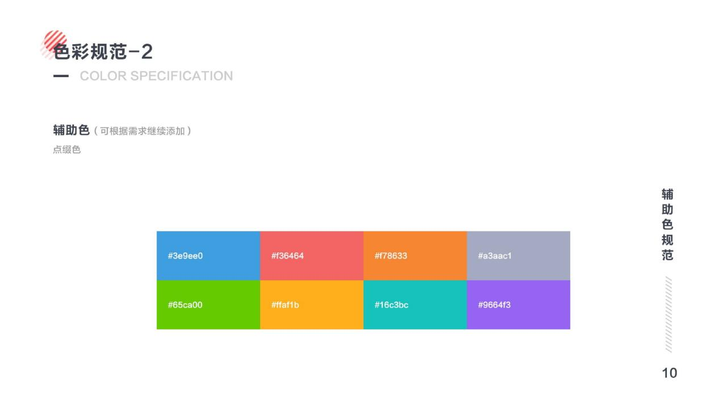

Slide 15
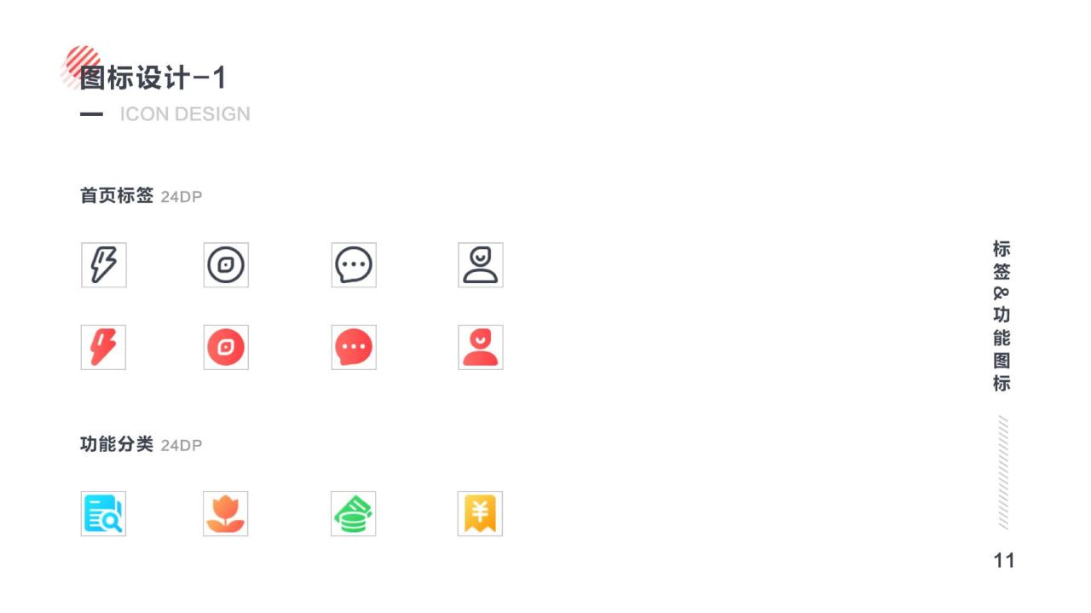

Slide 16
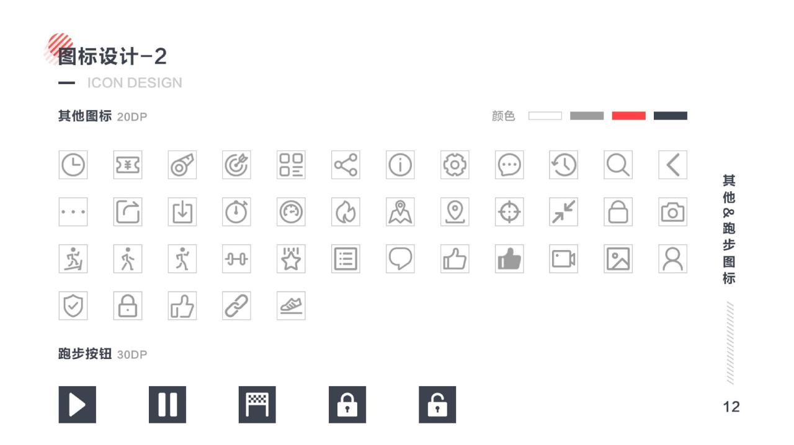

Slide 17
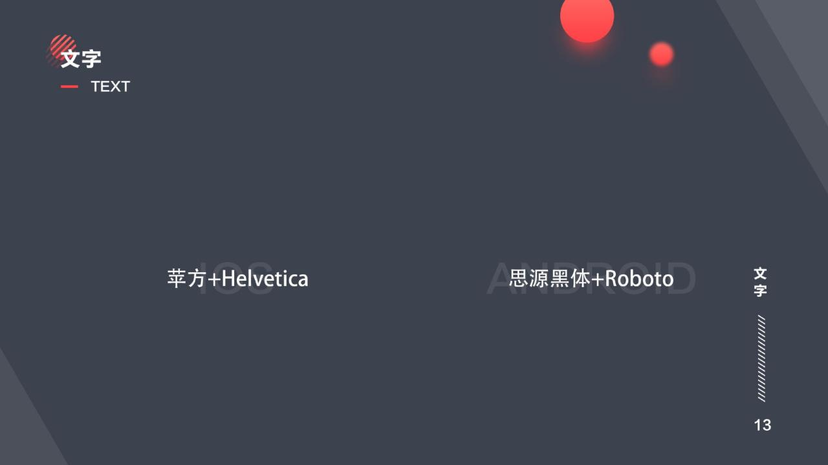

Slide 18
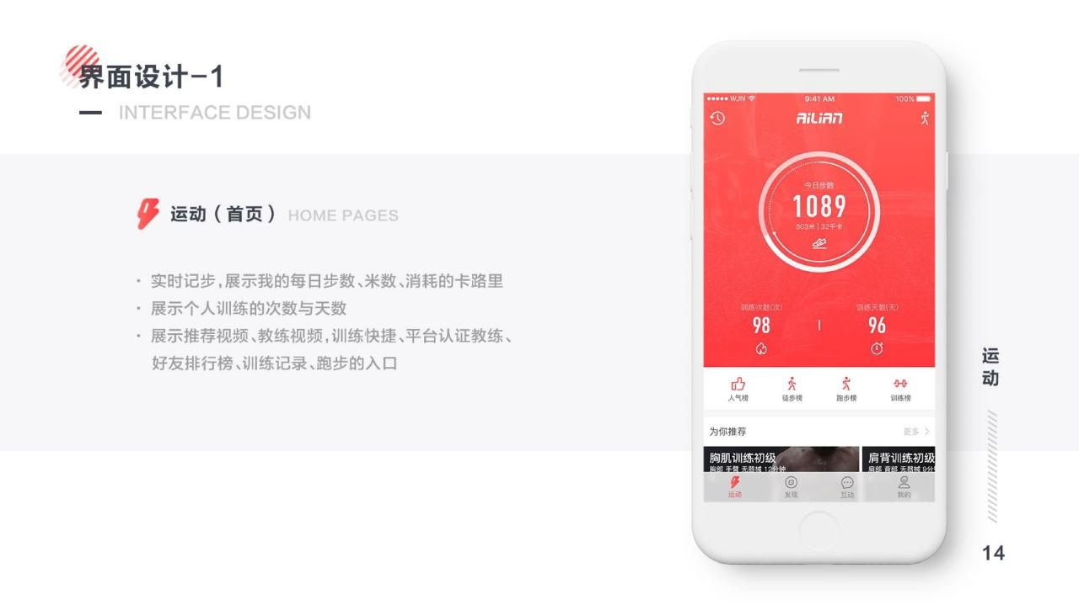

Slide 19
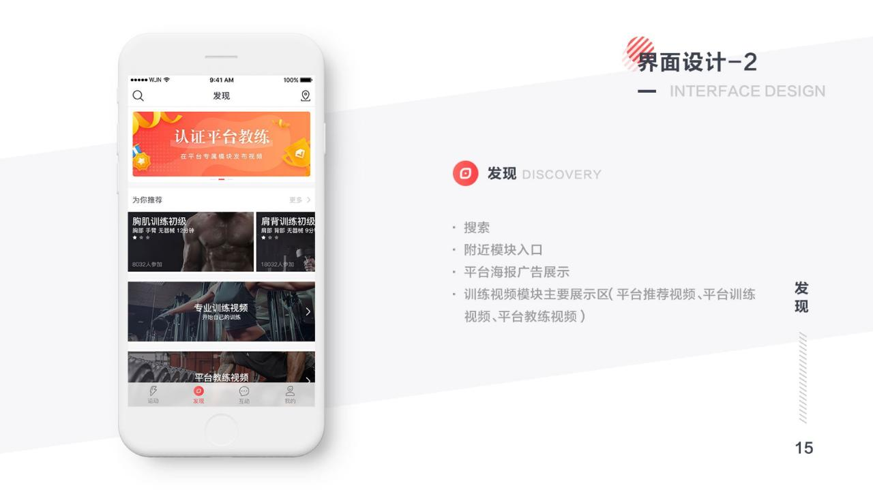

Slide 20
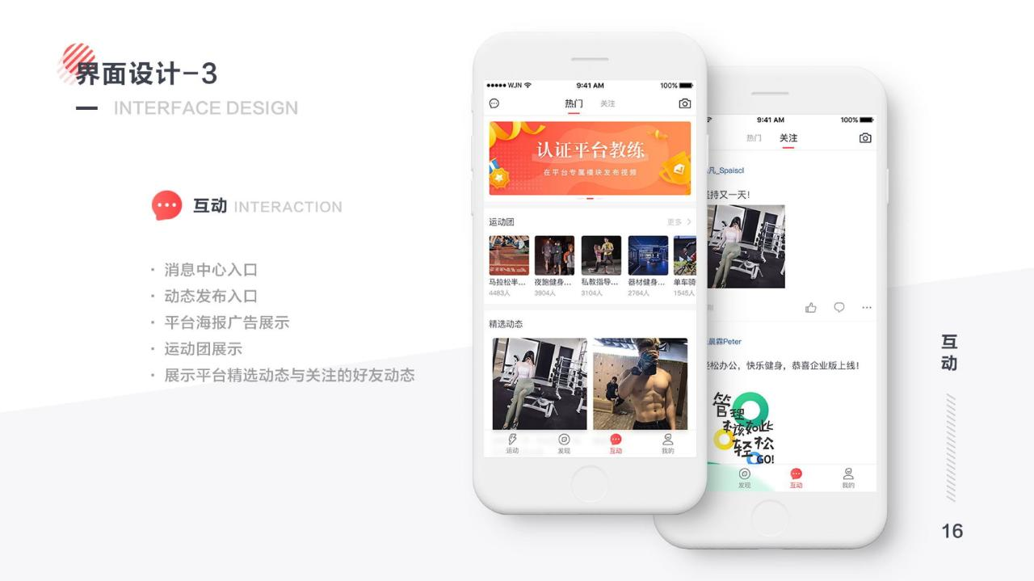

Slide 21
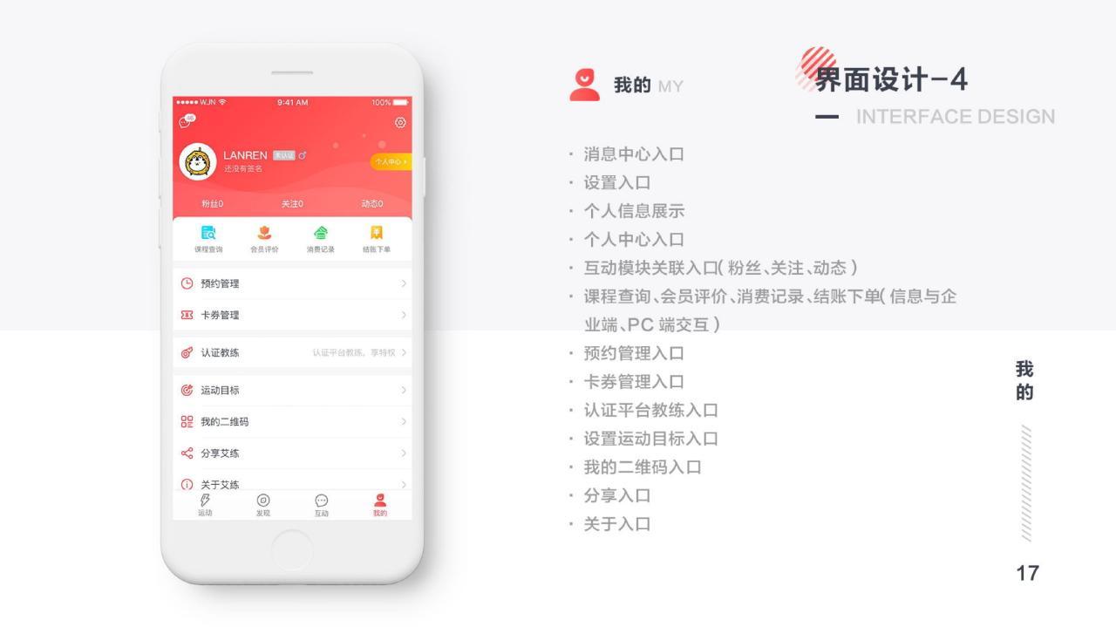

Slide 22
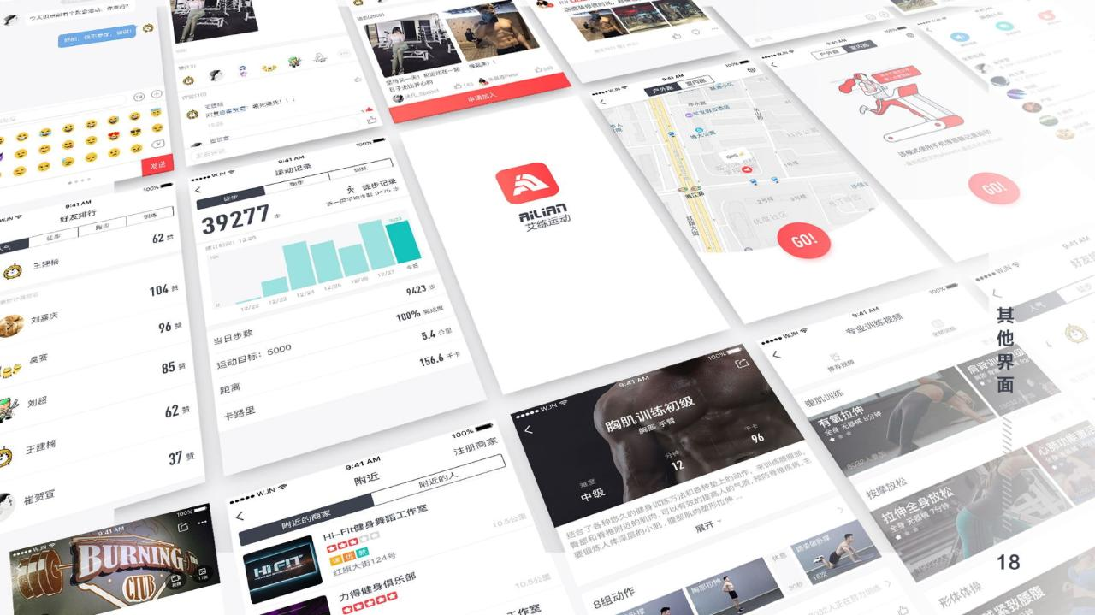

Slide 23
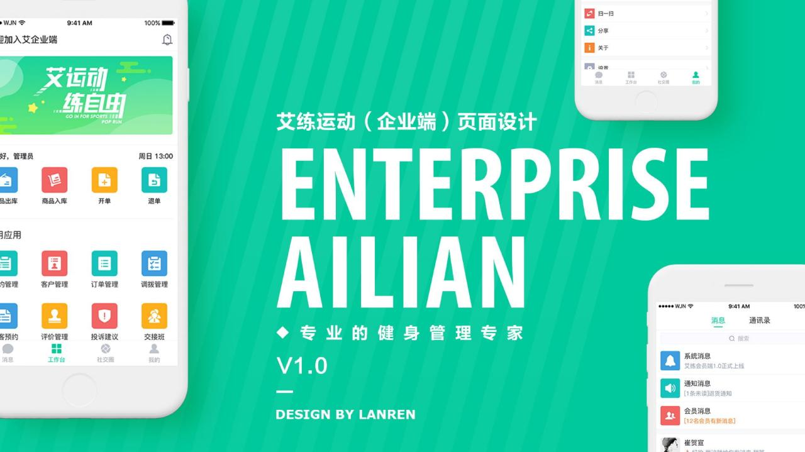

Slide 24
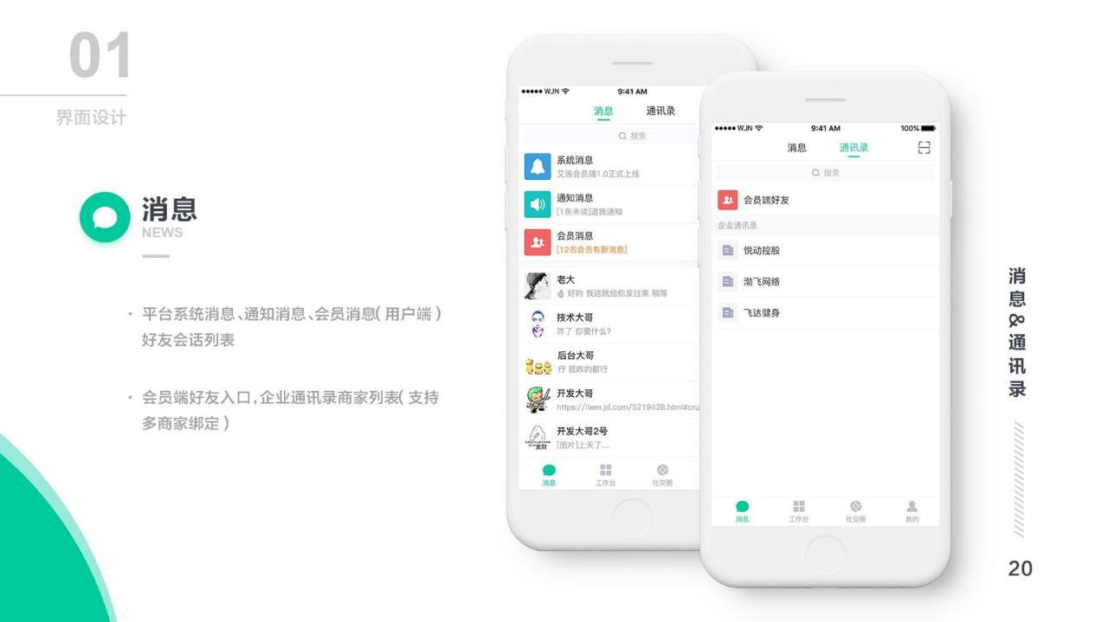

Slide 25
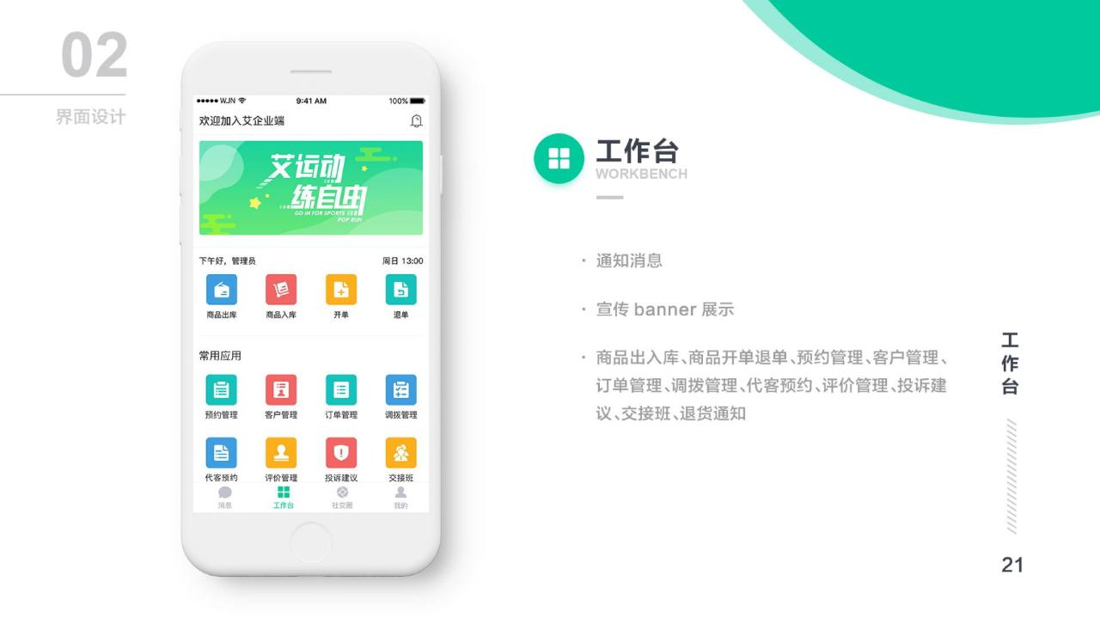

Slide 26
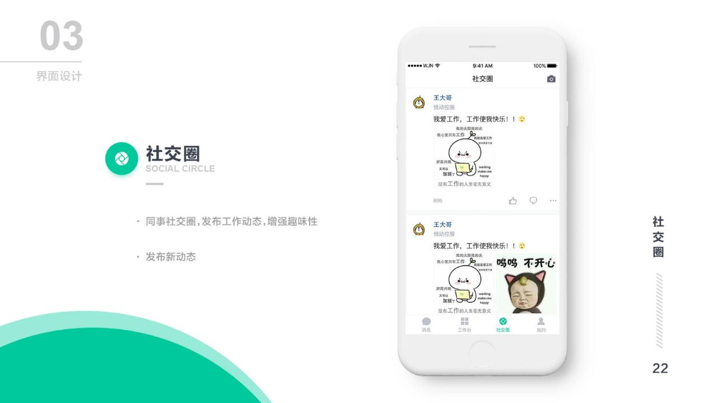

Slide 27
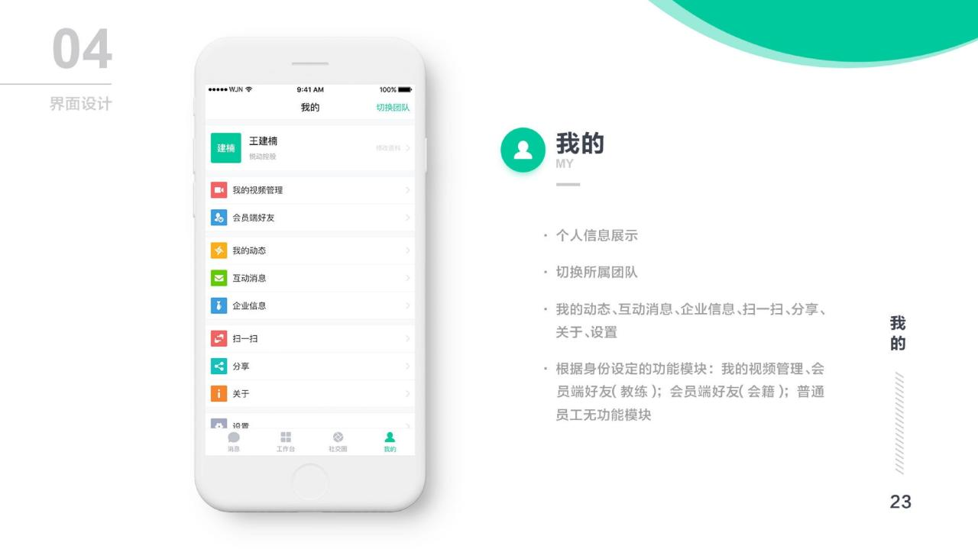

Slide 28
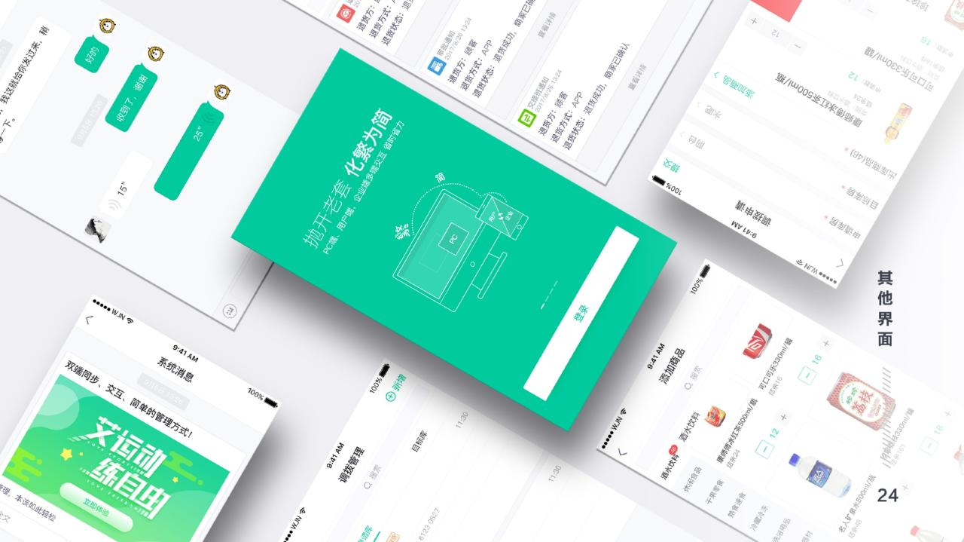

Slide 29


Slide 30
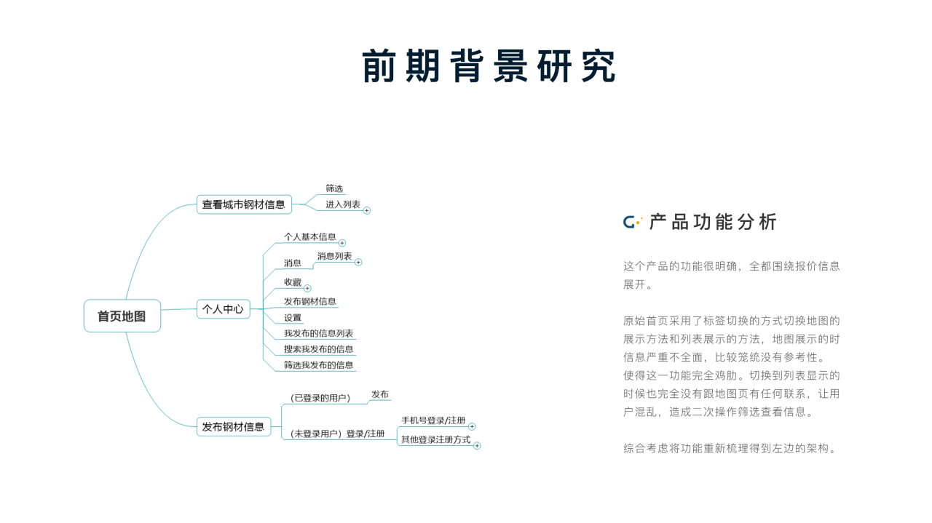

Slide 31
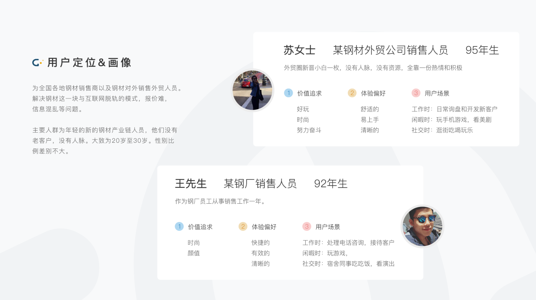

Slide 32
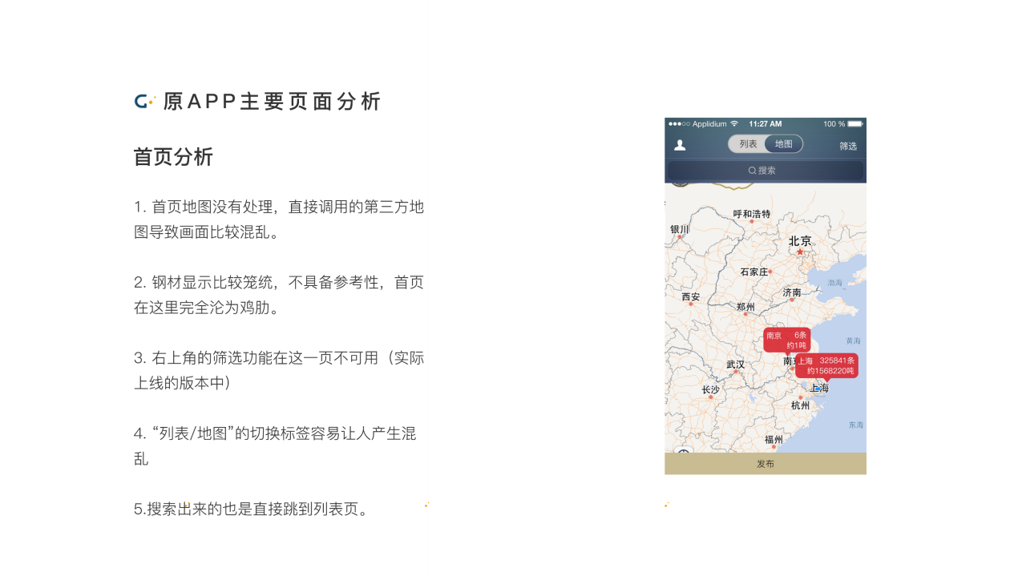

Slide 33
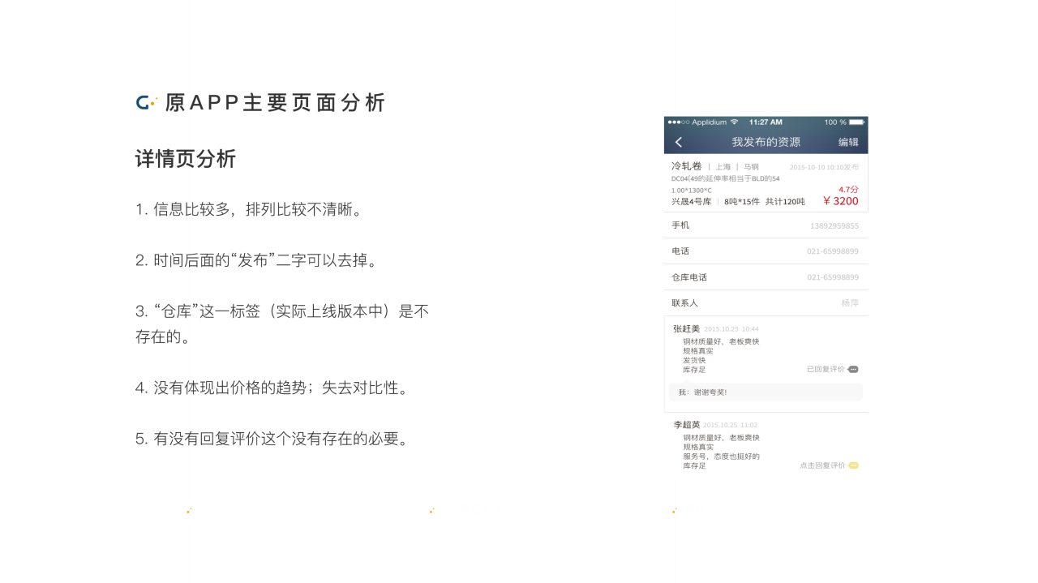

Slide 34
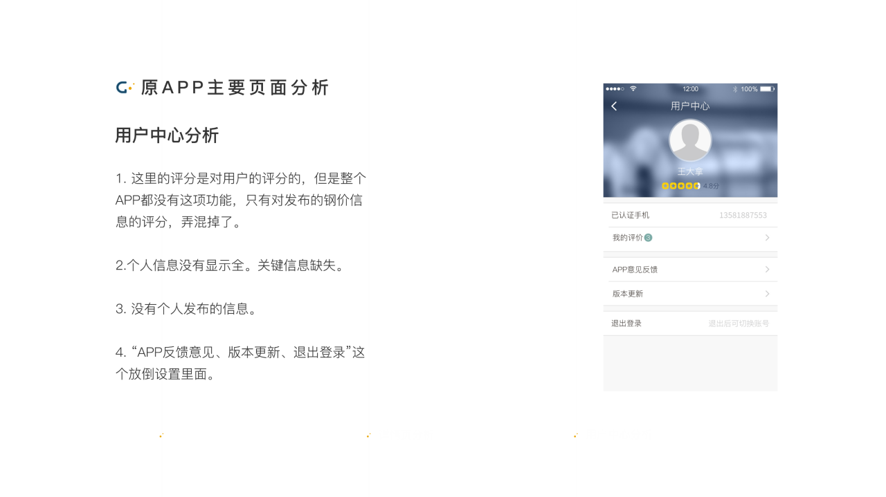

Slide 35
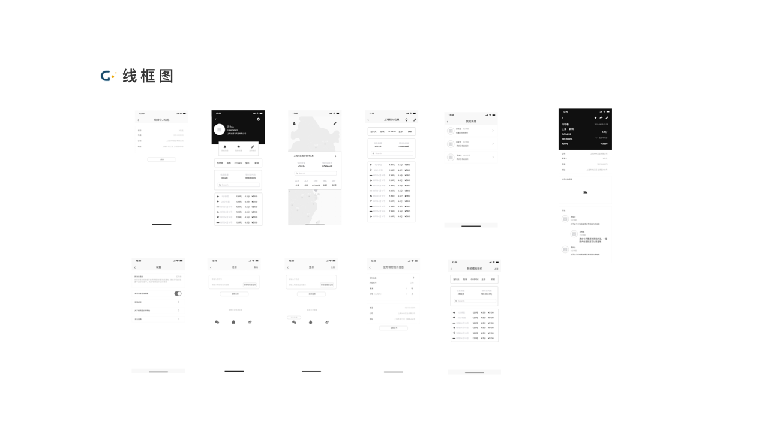

Slide 36
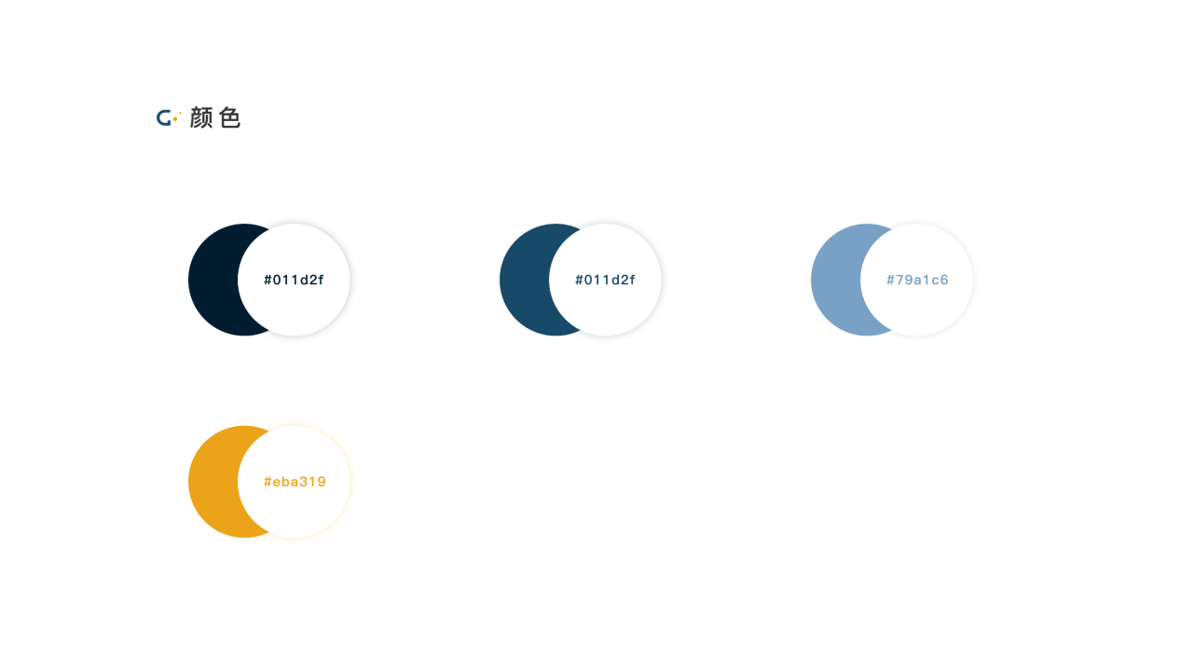

Slide 37
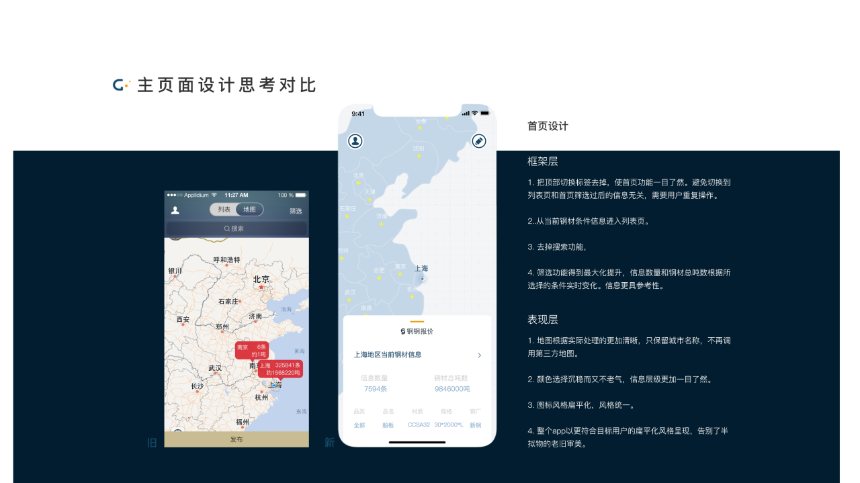

Slide 38
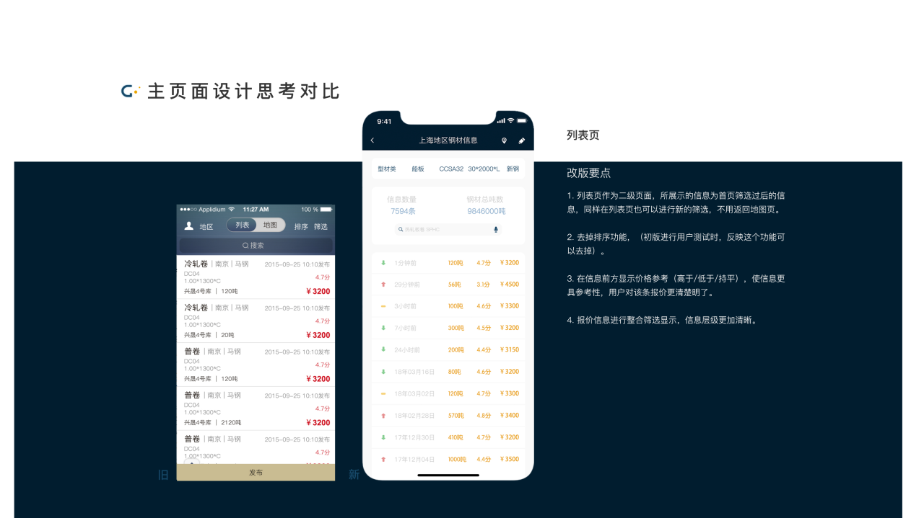

Slide 39
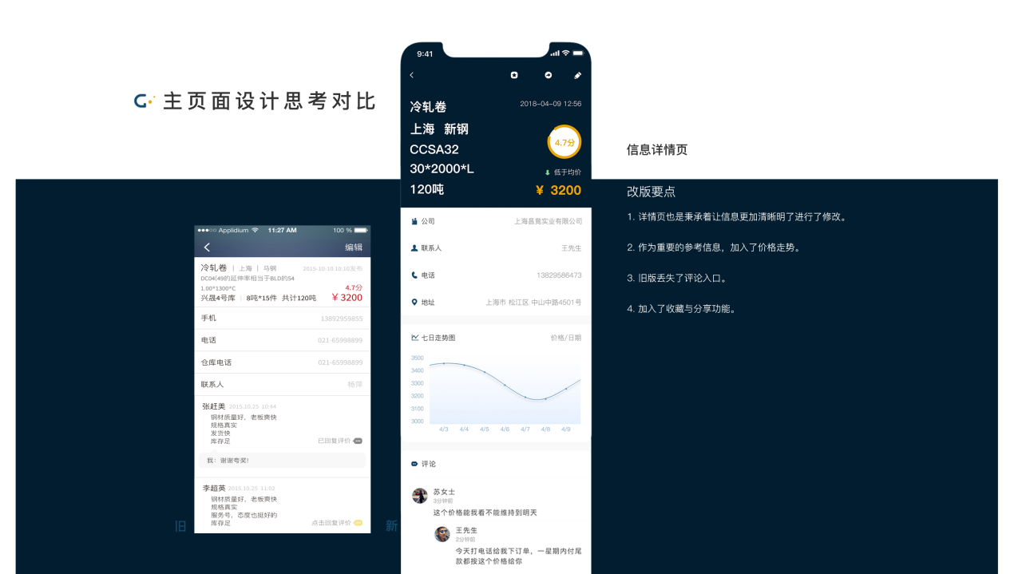

Slide 40
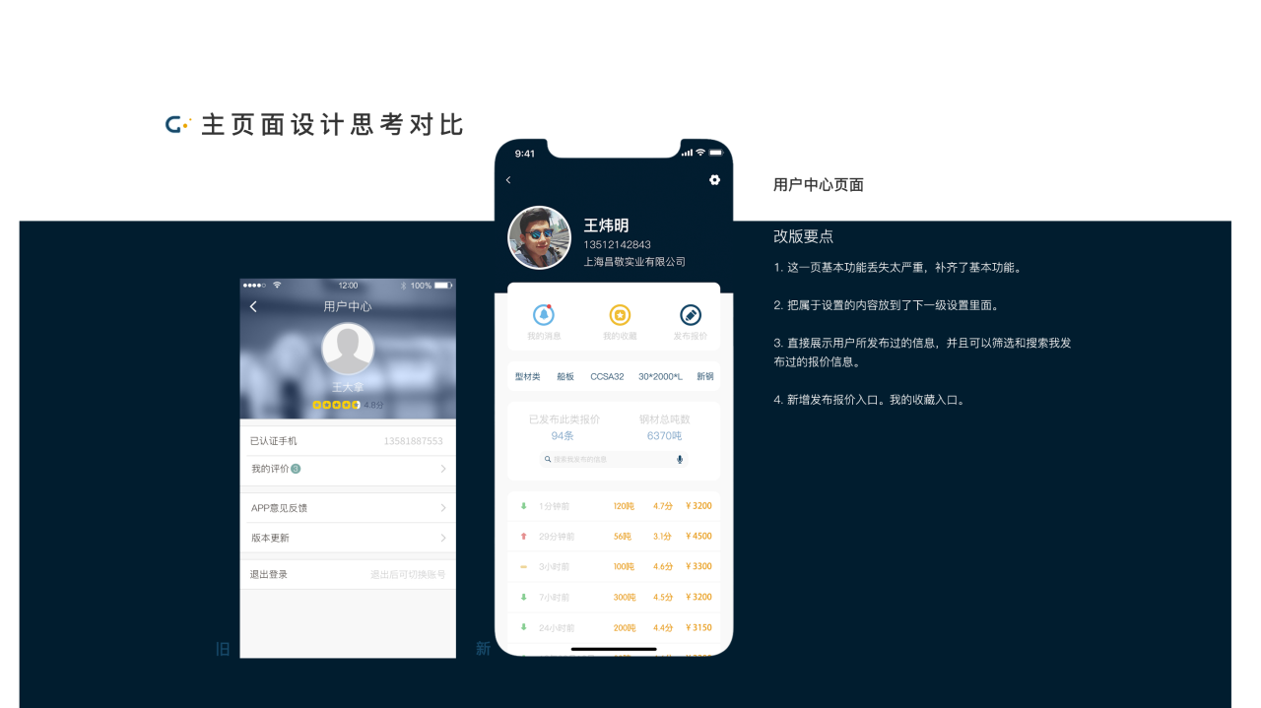

Slide 41
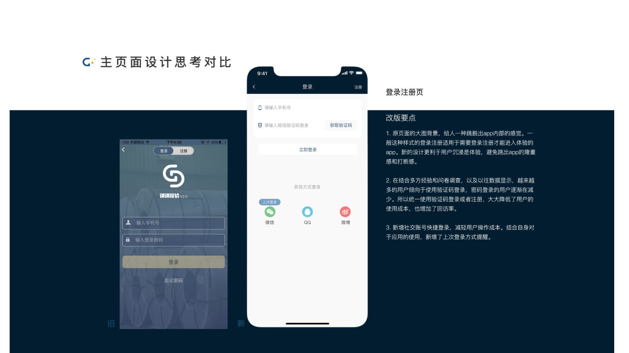

Slide 42
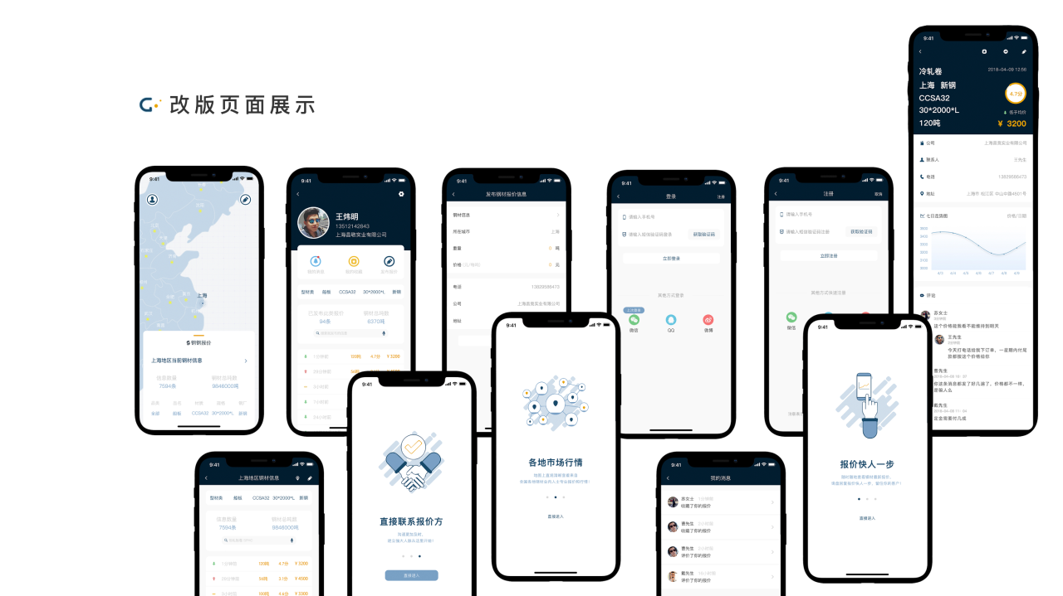

Slide 43


Slide 44
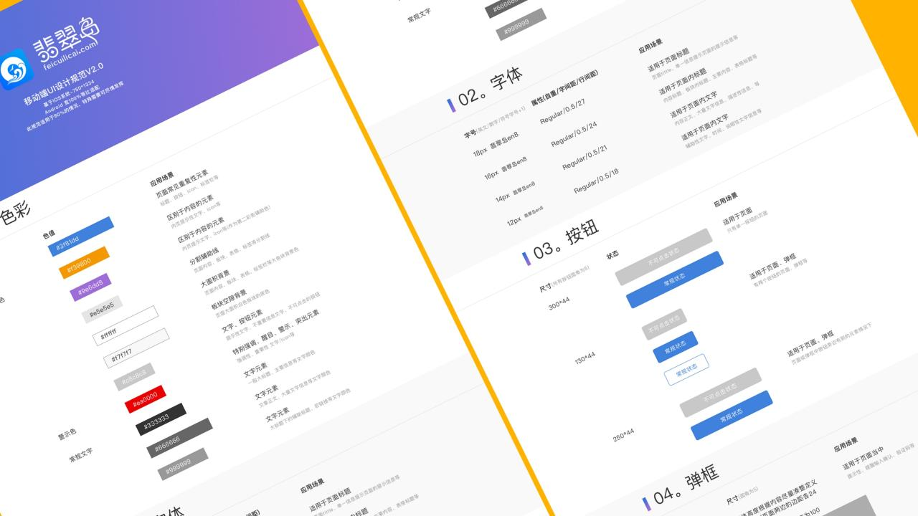

Slide 45


Slide 46

Web Design

Slide 47
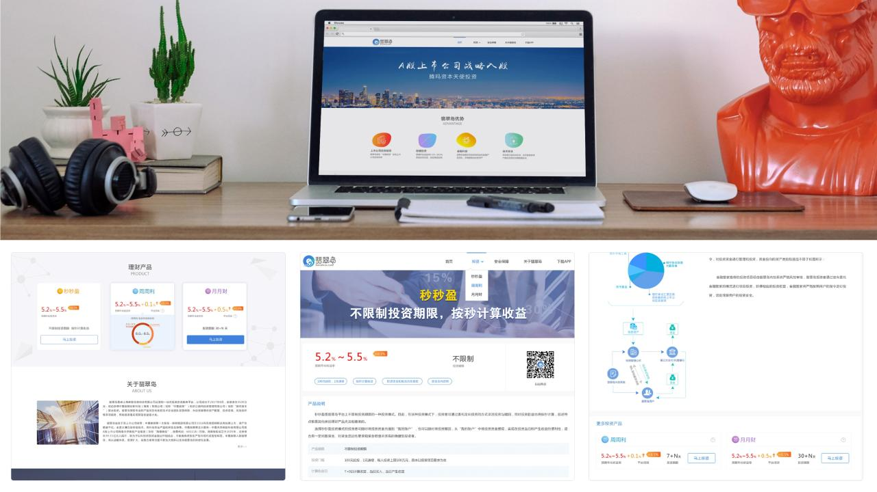

Slide 48
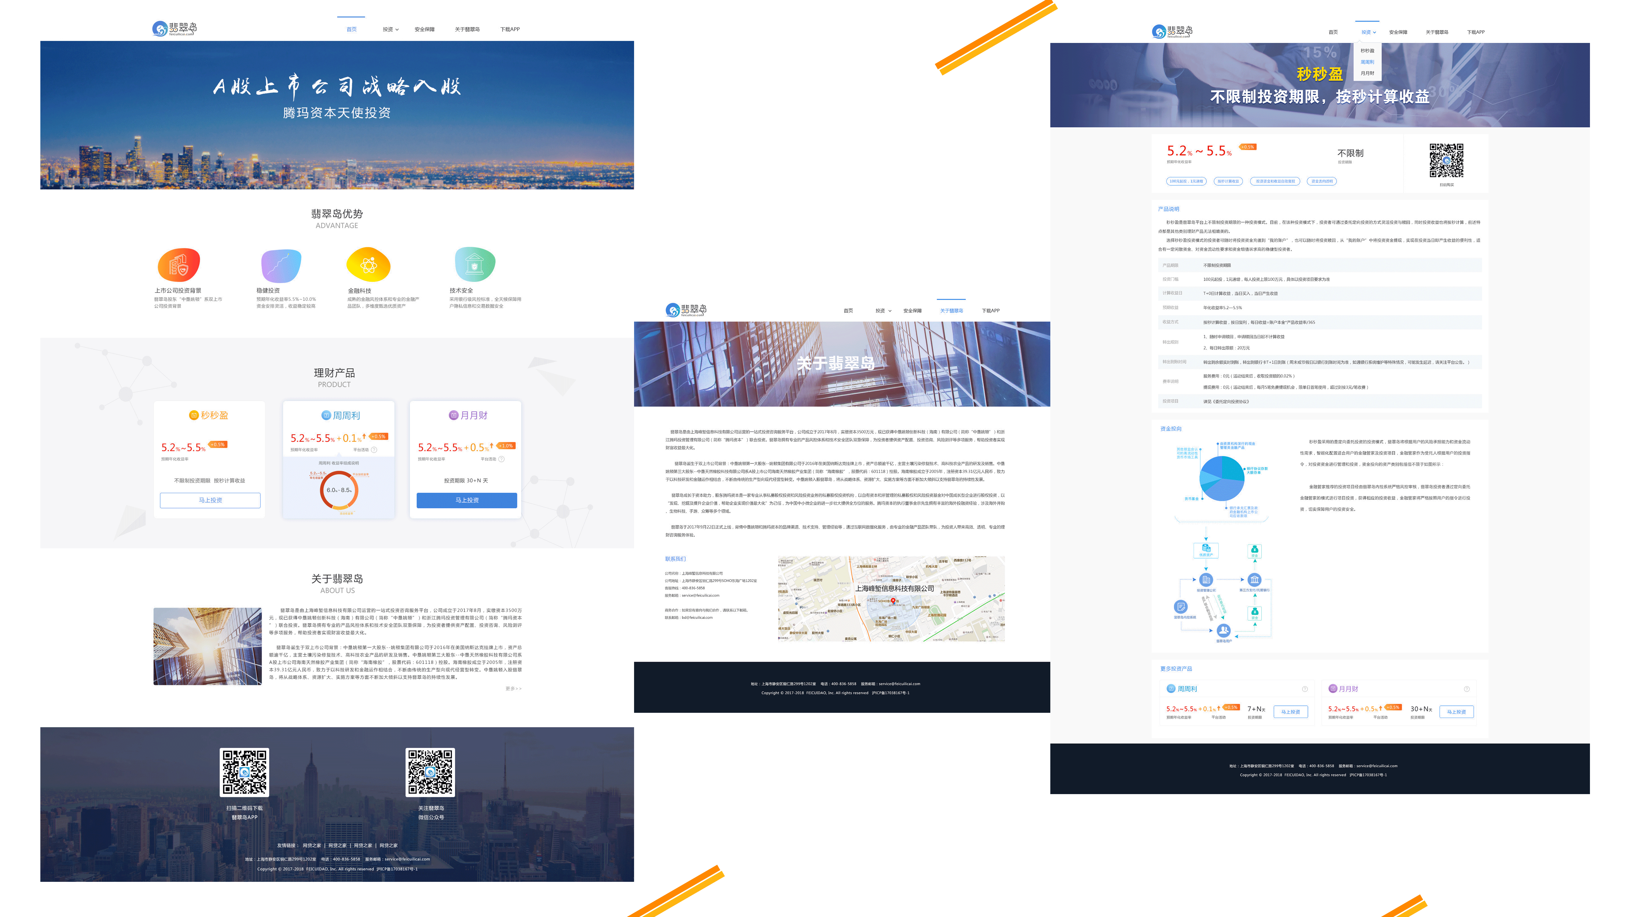

Slide 49
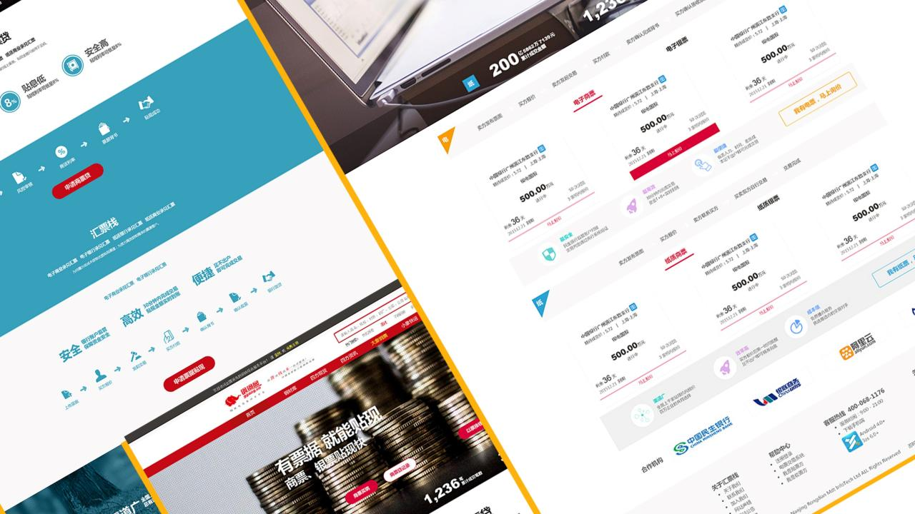

Slide 50
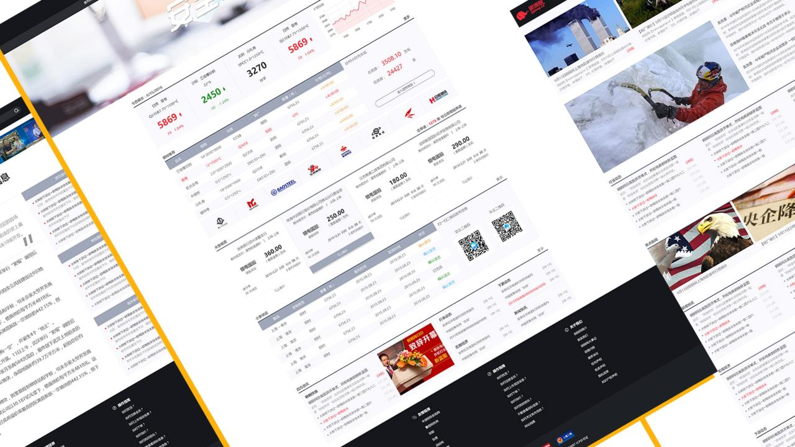

Slide 51
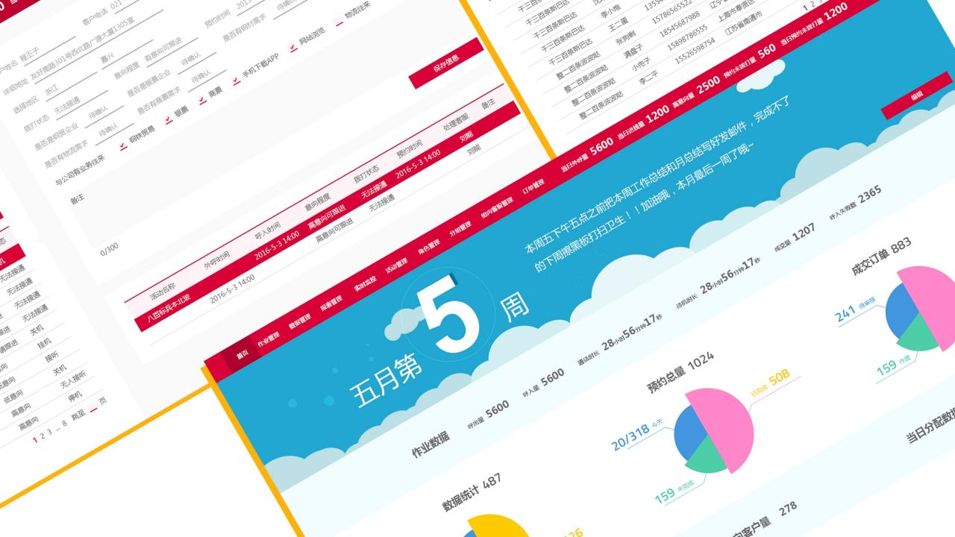

Slide 52
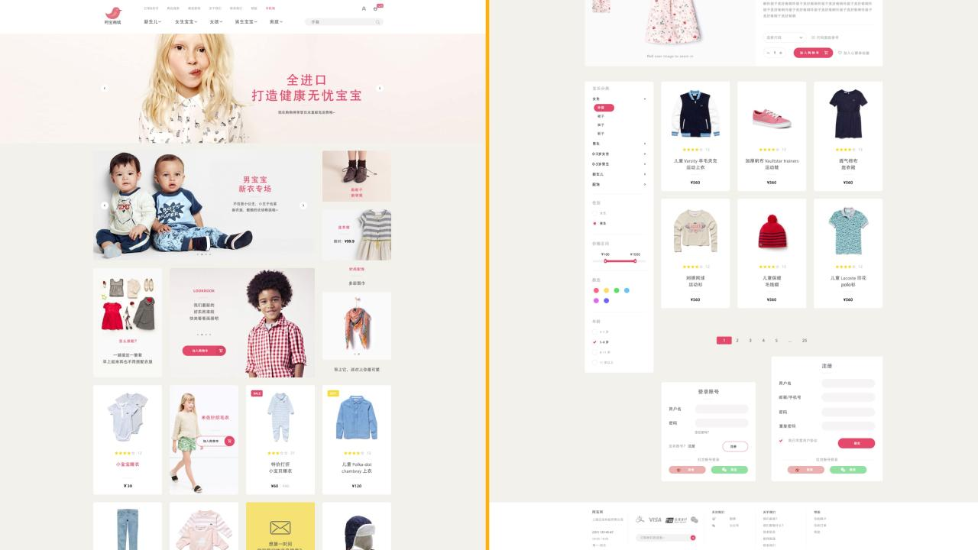

Slide 53

Graphic Design

Slide 54







Slide 55







公
众
号
海
报
设
计

Slide 56


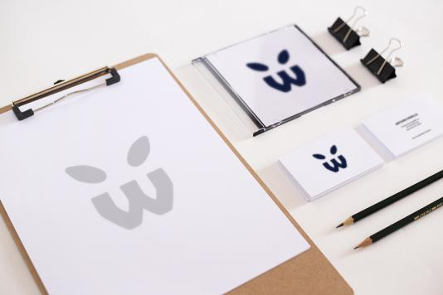

Slide 57


Slide 58


Slide 59

Commercial Photography

Slide 60








Slide 61



Thank You For Your Time!
Judy Feng
Phone:647-878-2843
Mail：judyfeng9@gmail.com
For more works:
http://studentweb.cencol.ca/yfeng66/myweb.html
If you click the play button, the duck will say “Thank you” in Chinese. :D

